Slide 1

Chapter 11
Personality

Slide 2

Humanistic Approaches
Focus on humans’ unique mental capabilities
Human behavior is motivated mainly by an innate drive toward growth
Prompts people to fulfill their unique potential

Slide 3
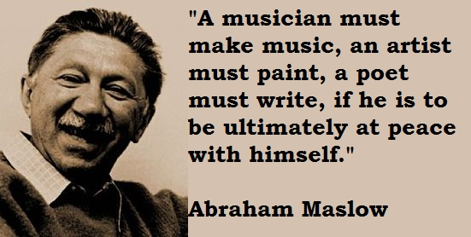
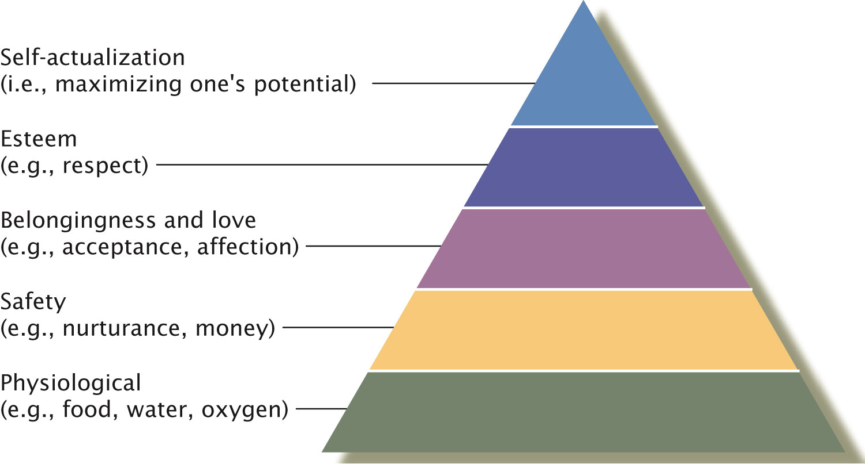
Maslow’s Growth Theory
Striving for self actualization
Realized through peak experiences
Notes:
3

Slide 4
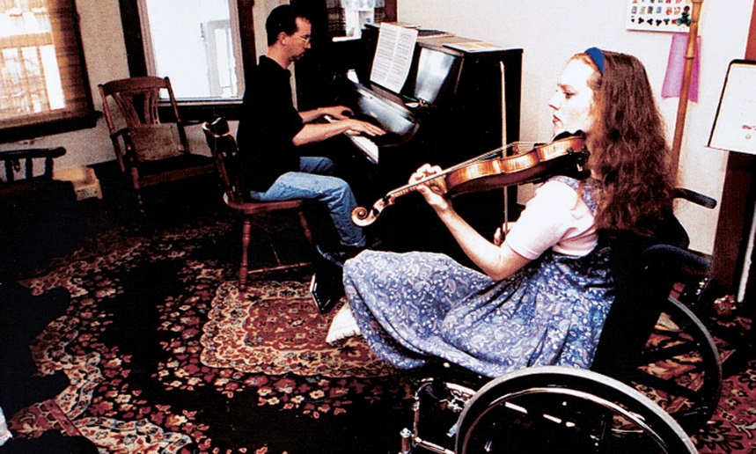
Personality in Maslow’s Growth Theory
Deficiency motivation: Focus on what’s missing
Growth motivation: Focus on satisfactions in life
Rachel Barton Pine has a growth orientation. The accident that took her leg didn’t destroy her joy in life, nor her career as a concert violinist. http://rachelbartonpine.com/

Slide 5
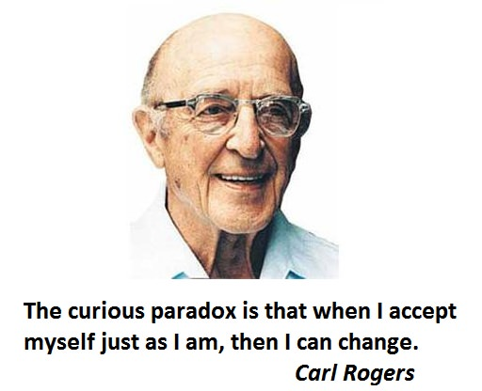
Rogers’s Self Theory
Development of the self
Drive for self-actualization
Divided the self into two categories:
Ideal self
Real self
Congruence vs. incongruence between the ideal and the actual self.

Slide 6
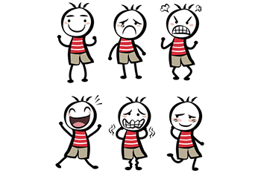
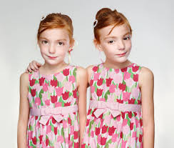
Biological Approaches
Minnesota Twin Study
350 pairs of twins
Identical vs. fraternal twins reared together and apart
Findings: identical twins, whether raised together or apart, have very similar personality
Temperament
Inborn pattern to react to the world
Two dimensions:
Reactivity
Self-regulation

Slide 7
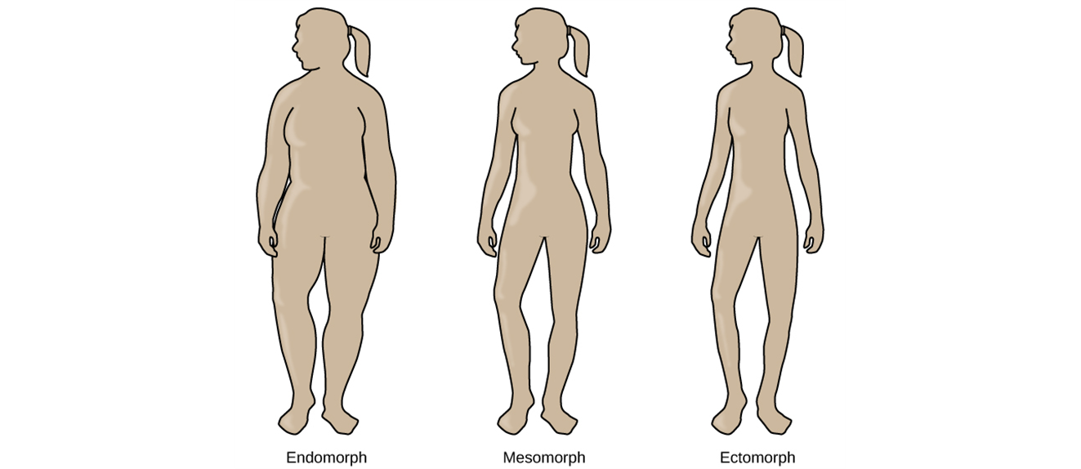
Not well supported!
Ectomorphs: thin with a small bone structure, very little fat (Adrien Brody, Nicole Kidman)
Artistic, quite, thoughtful, private; enjoy intellectual stimulation
Endomorphs: narrow shoulders and wide hips, extra fat on round bodies (Queen Latifah, Jack Black)
Relaxed, good sense of humor, sociable
Mesomorphs: fall between (Channing Tatum, Scarlett Johannson)
Adventurous, competitive; can be obnoxious and aggressive.

Slide 8
Trait Theorists
Assumptions:
Personality traits are stable over time
Personality traits are stable across situations
People have different degrees of particular personality traits

Slide 9
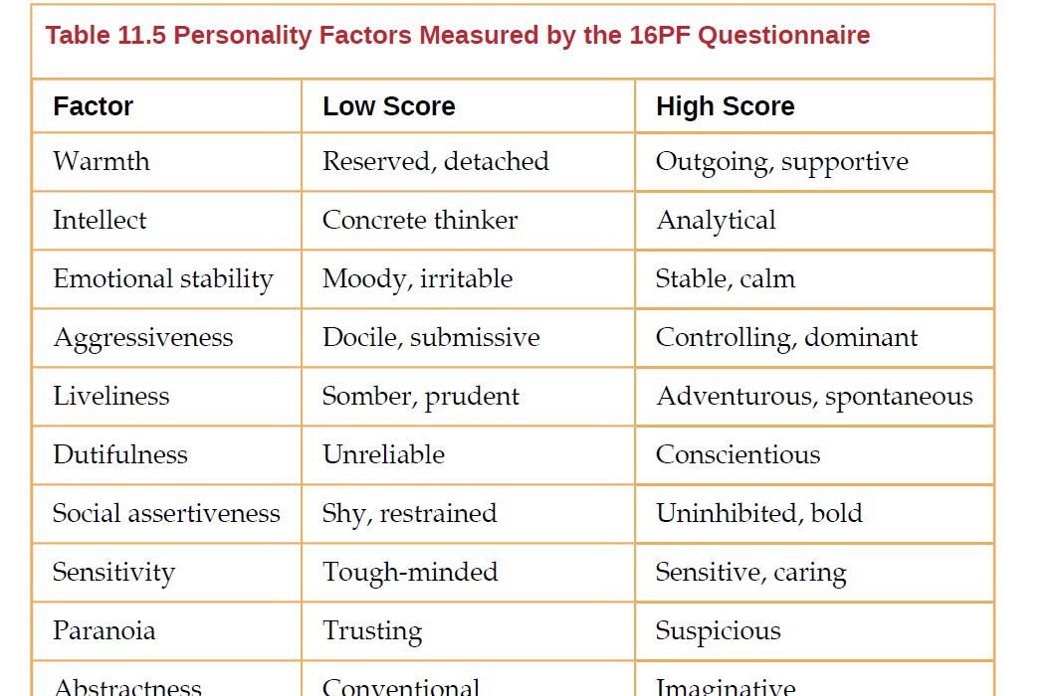
Early Trait Theories
Gordon Allport
Central traits
Secondary traits
Raymond Cattell
Used factor analysis
16 clusters of traits make up the basic dimensions of personality (16PF)
Notes:
9

Slide 10
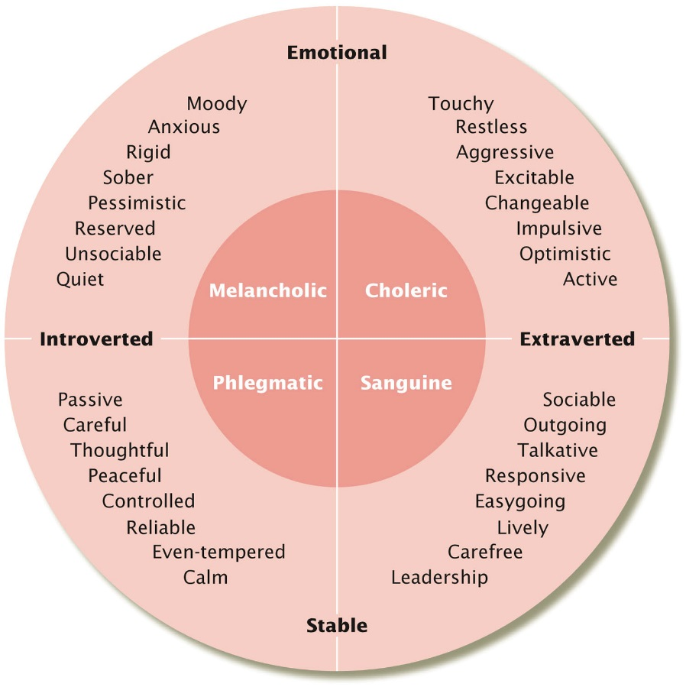
Biological Trait Theories: Hans and Sybil Eysenck
Based on inherited differences in the nervous system
Two dimensions
Introversion-extraversion
Need for arousal
Emotional stability
Sensitivity to stress
Notes:
10

Slide 11
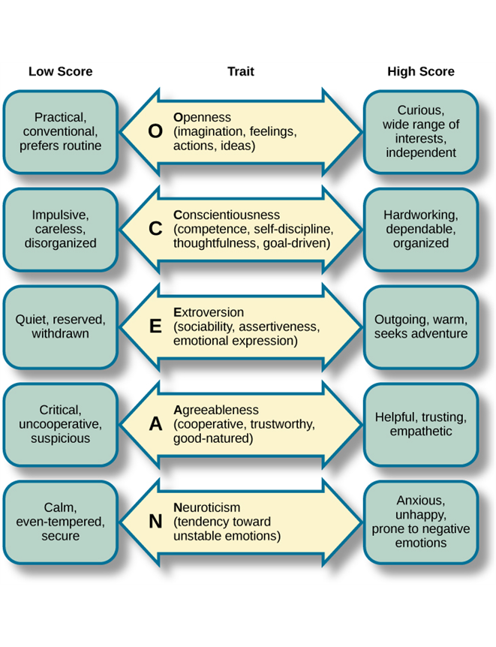
Costa & McCrae’s Five Factor (Big-Five) Model of Personality
Openness to experience
Conscientiousness
Extraversion
Agreeableness
Neuroticism
Seen across many cultures
Notes:
11

Slide 12
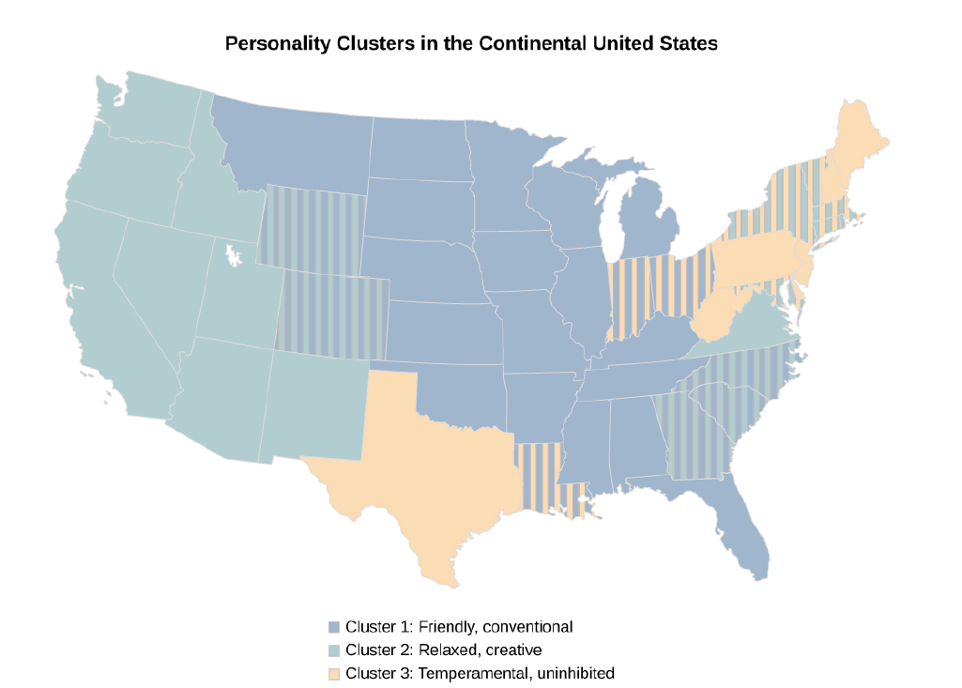
Culture and Personality
The strength of personality traits varies across cultures.
Individualistic and collectivistic cultures
Notes:
12

Slide 13
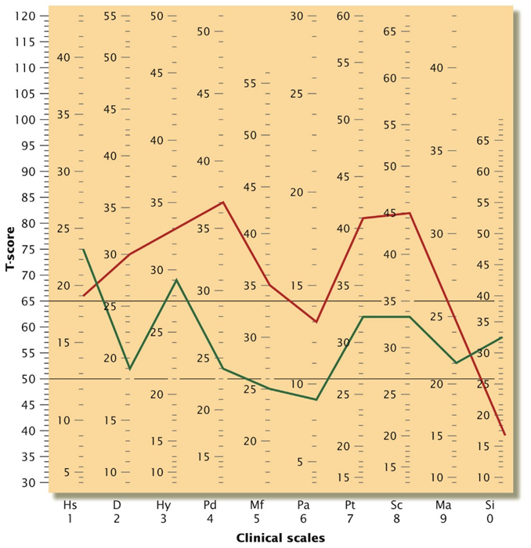
Assessing Personality: Self-report Inventories
Multiple choice items
Likert scale
Minnesota Multiphasic Personality Inventory (MMPI)
Depression
Hysteria
Psychopathic deviance
Schizophrenia
…
Notes:
13

Slide 14
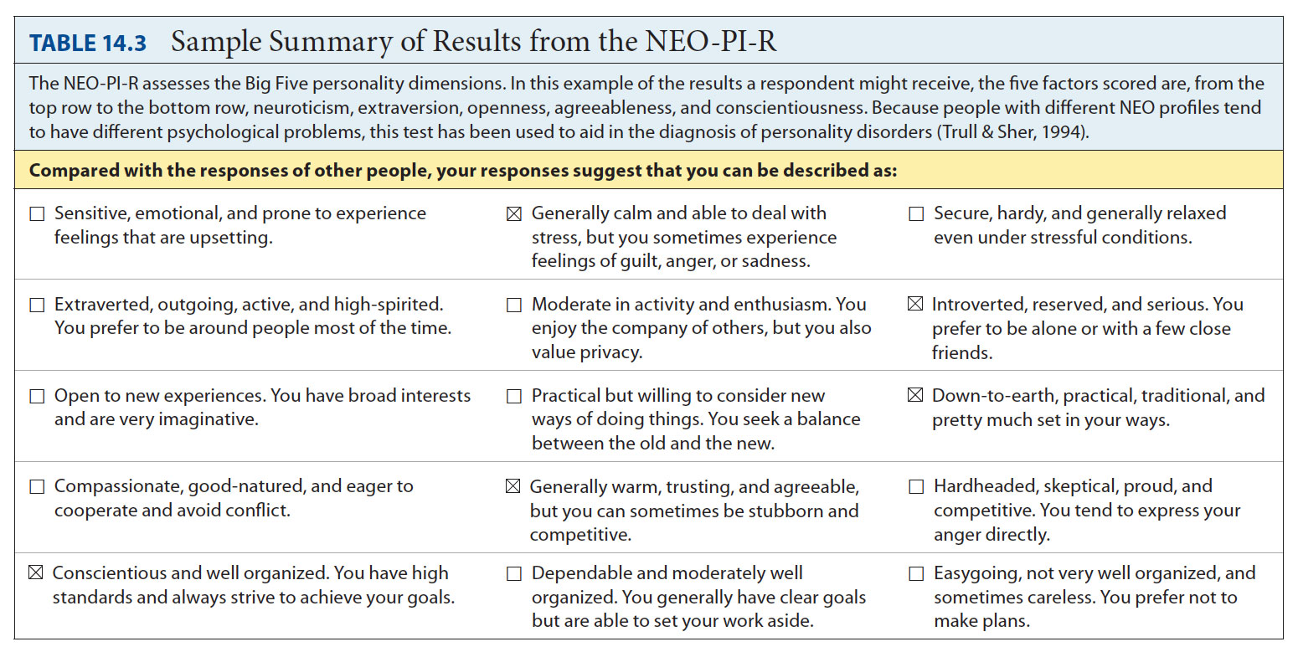
Nonprojective Personality Measures
Neuroticism Extraversion Openness Personality Inventory, Revised (NEO-PI-R)
Notes:
14

Slide 15
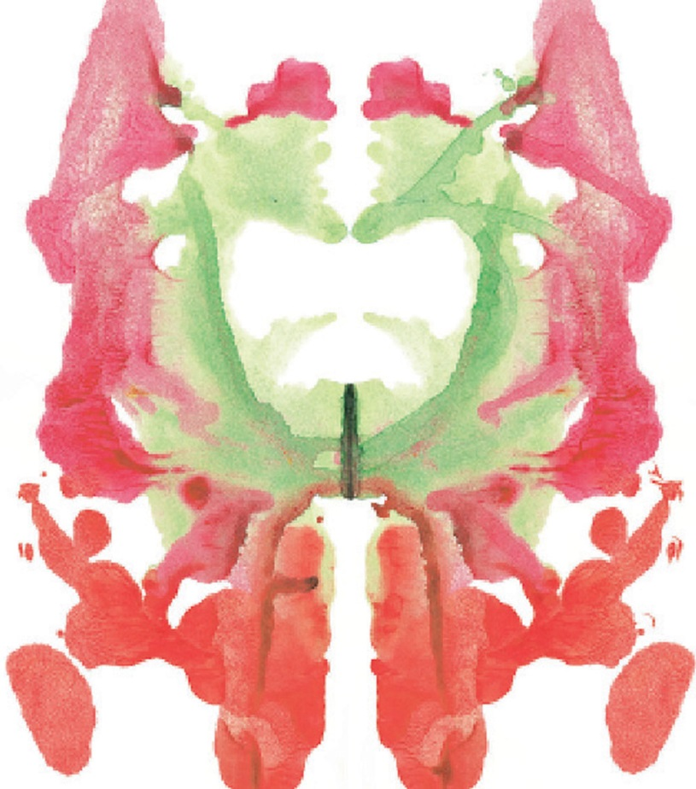
Assessing Personality:Projective Personality Measures
Rorschach Inkblot Test
Notes:
15

Slide 16
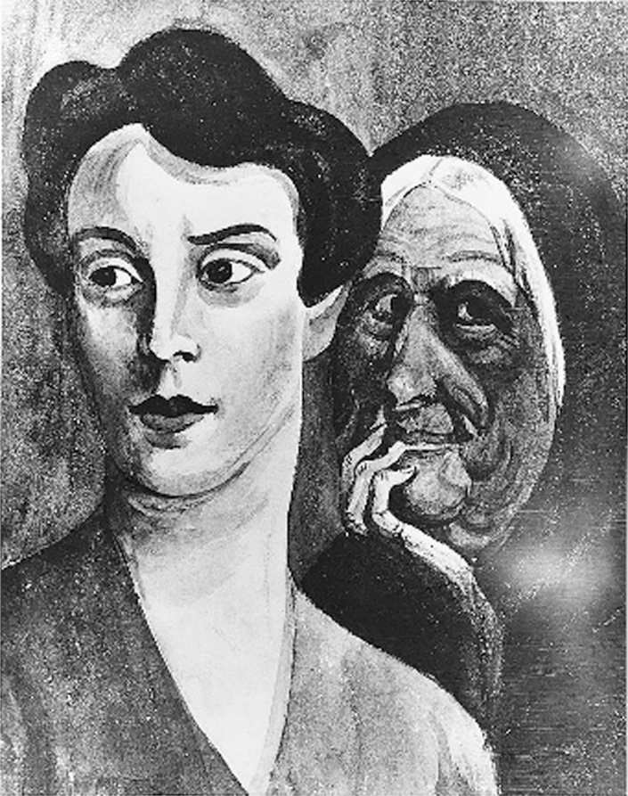
Projective Personality Measures
Thematic Apperception Test (TAT)
Notes:
16

Slide 17
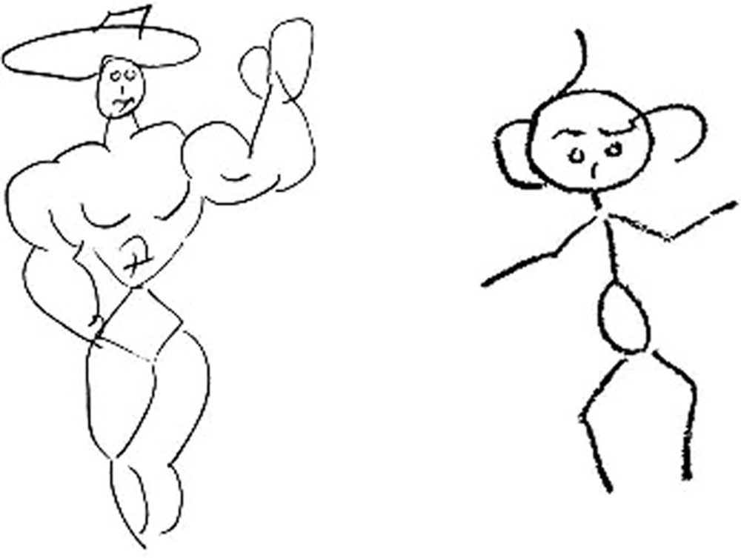
Projective Personality Measures
Draw-a-person test
Notes:
17

Slide 18
Personality Tests and Employee Selection
Nonprojective tests may guide hiring decisions
Problems
Measured traits are too general to predict specific aspects of job performance
Measured traits may influence performance in some job situations, but not others
Seen by some as an invasion of privacy
Concerns about test interpretation and use
Back to TOC

